Slide 1


Tools that will help you throughout Life
Key:
Desktop Word --> Online Word
Download a Document
Find Tool
Replace a Word Tool
How to comment on a document
Double-Space Word Doc
Ruler tool
Alphabetical Order
Share a Word/PowerPoint
Attach a doc to an email
Changing chrome PDF to Word Doc
File on Flash Drive
Create a Folder on a Flash Drive
Dana Zolla
Quarter 4 Project

Slide 2
How to open Desktop Word on Online Word
When you are on online Word, there will be a button next to "Help" labeled "Editing"
When you click "Editing", a tab labeled "Open in Desktop App" will pop up – click that and that's it!

Slide 3

How to Download a Document
Online Word
  Click "File" in the upper left-hand corner
  Click "Save As"
  Click "Download a Copy" referring to a Word Document OR Click "Download as PDF" - depending on how you need the document.
Desktop Word
  Click "File" in the upper left-hand corner
  Click "Save a Copy"
  Now you can either download it to your OneDrive or the PC if you want to put it on the flash drive (look in later slides)

Slide 4

The Find Tool
Both Online & Desktop Word
  CTRL + F
Desktop Word
  In the upper right-hand, there is a "Find" button with a magnifying glass – Click it

Slide 5

Replace a Word Tool
Open to Desktop Word
  In the upper right-hand, there is a "Find" button, under that is a "Replace" button – click it
Online Word
  CTRL + H

Slide 6
How to Comment
Word Document
Highlight the word(s) you want to comment on
A tool bar will pop up
Click "New Comment"
Power Point
Under the slide there is a "Notes" Section, you need to put your curser over the line under the slide and then click and drag the "Notes" section up

Slide 7
How to Double Space your Word Document
Open to Desktop Word (Slide 2)
1
Highlight/Select paper
2
On the tool bar – in between the align words tools, and the paint bucket there is a button that on the left side as arrows going up and down next to four lines – Click it
3
Click "2.0"
4

Slide 8
How to use the Ruler tool
Open document to Desktop Word (Slide 2)
If ruler did not automatically pop up at the top of the screen, then...
Click "View" button
In the "Show" section, there is a Check Box with "Ruler" Labeled – Click it

Slide 9

How to Place References in Alphabetical Order
Open to Desktop Word (Slide 2)
Highlight/Select what you want in alphabetical order
In the middle of the tool bar there is a button that has a blue "A" above a black "Z" with an arrow going down – click it
Then a screen will pop up asking you if you want it ascending (ABC) or if you want it descending (ZYX) - it will automatically be placed in ascending (ABC) so just click "Ok"

Slide 10

How to Share a Document/Power Point
In the upper right-hand corner, there is a button that says "Share" (on Word it's blue, on Power Point it's burnt orange).
Click it
Type to whom you would like to send the document/Power Point to.

Slide 11


Attach a Document too an Email
Way 1
Way 2
You want to Download the document (look on Slide 3)
Create the email to the recipient
Drag and drop from the bottom of the screen to the email
Create the email to the recipient
Click the paperclip icon or the attach button
EITHER click the recently opened documents OR open files
Click "Attach Copy to Email"

Slide 12

Changing Chrome PDF to Word Doc
Right-click on the PDF file in the file list and select Open With > Google Docs.

Slide 13
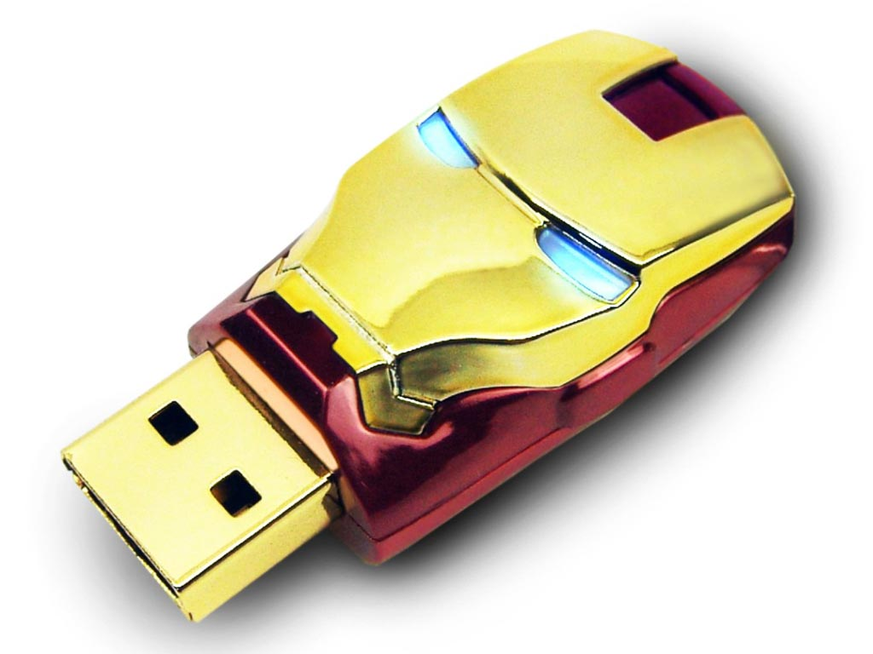
How to Put a File onto a Flash Drive
Download the file you want to put on the flash drive (Slide 3)
Open "Files"
Click "USB Drive (D:)"
Drag and Drop file into "USB Drive"

Slide 14
How to Create a Folder in a Flash Drive
When in the Flash Drive, Right Click
1
Click "New"
2
Click "Folder"
3
Name the Folder
4
Drag and drop the files you want to place in the folder
5

